Slide 1
Lean UX

Slide 2





@sretiere
#AgileFrance17

Slide 3
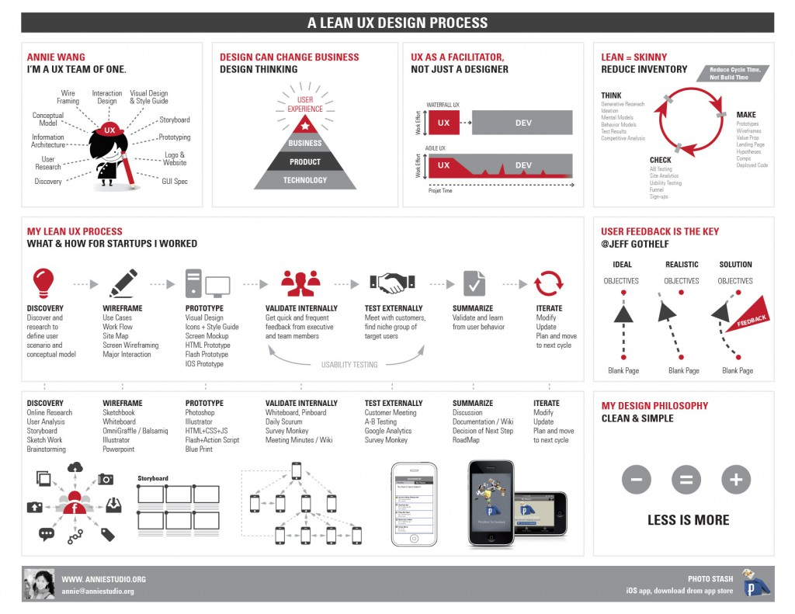
Lean UX

Slide 4
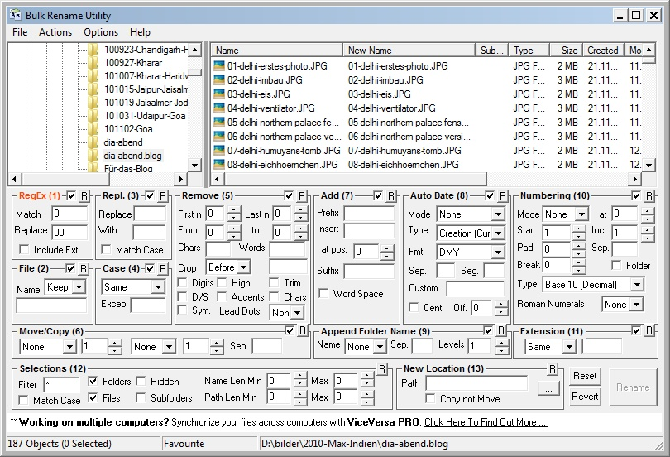
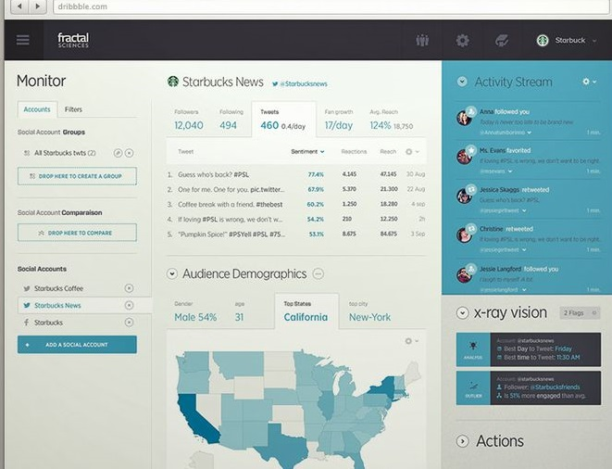
UX ?

Slide 5
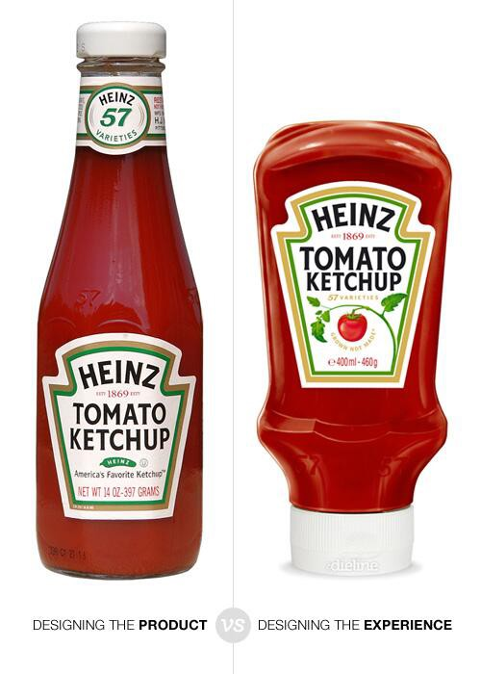
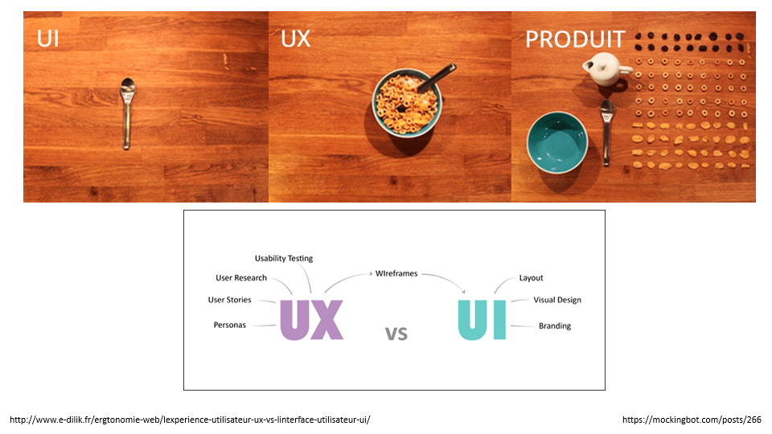
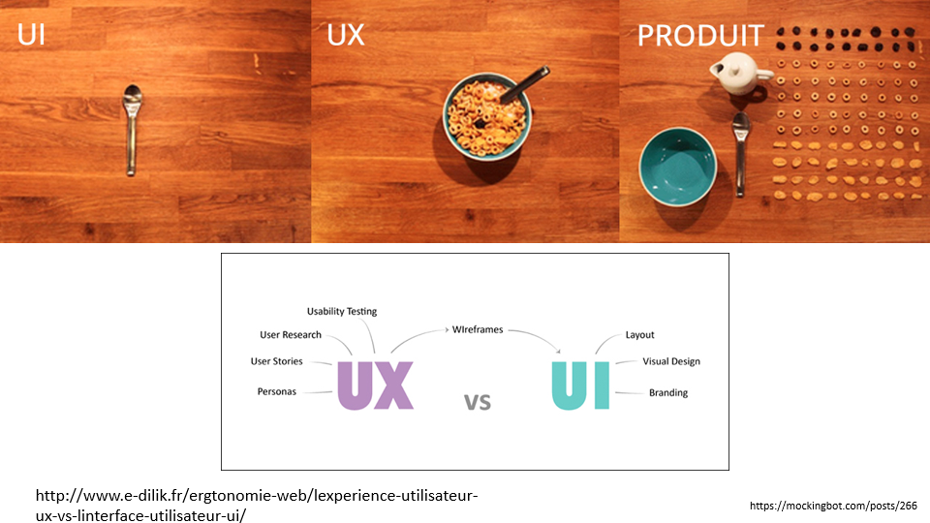
Même chose ?
https://www.codelitt.com/blog/ux-vs-ui/

Slide 6
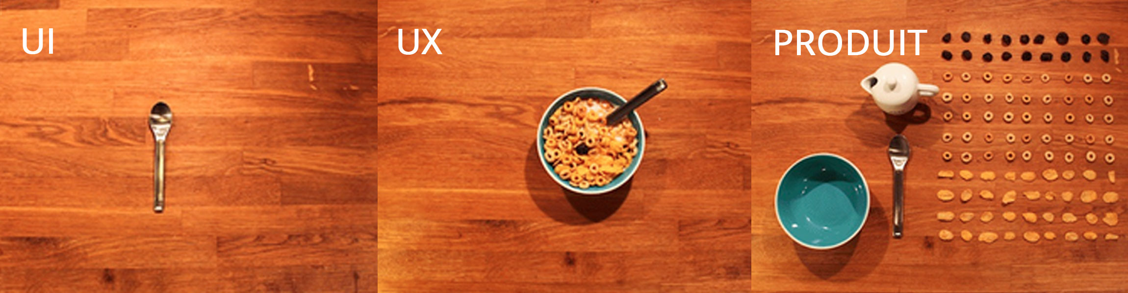

http://www.e-dilik.fr/ergtonomie-web/lexperience-utilisateur-ux-vs-linterface-utilisateur-ui/
https://mockingbot.com/posts/266

Slide 7
Design
Compréhension
Idéation
Adoption

Slide 8

Et le lean dans tout ça ?
https://www.flickr.com/photos/39908901@N06/8129765828

Slide 9
Option 1
UX
Waterfall
Dev

Slide 10

https://www.flickr.com/photos/oregondot/5495544216

Slide 11
Option 2
UX
Agile
Dev

Slide 12

https://www.flickr.com/photos/peplop/6113686643/

Slide 13
Option 3
UX
Agile

Slide 14

https://www.flickr.com/photos/s2ublack/9270943672

Slide 15
